Slide 1
God’s Story, our story
The story of the Bible and our place within it

Slide 2
Aims
To provide space to look at the Bible
To introduce ourselves to the different parts of the story of the Bible
To be more comfortable in using the Bible in our lives and in the life of our Church

Slide 3
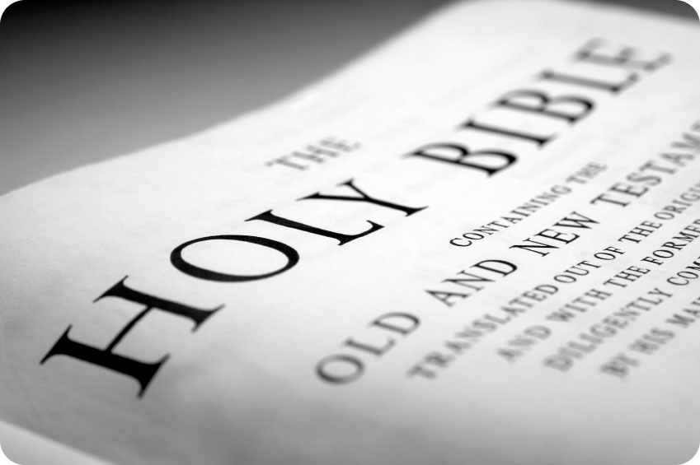

Opening Activity
What three words spring to mind when you hear the words: ‘the Bible’?

Slide 4
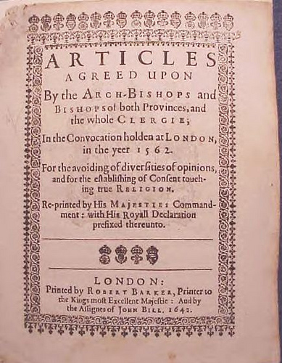
The Church of England
Holy Scripture containeth all things necessary to salvation

Slide 5
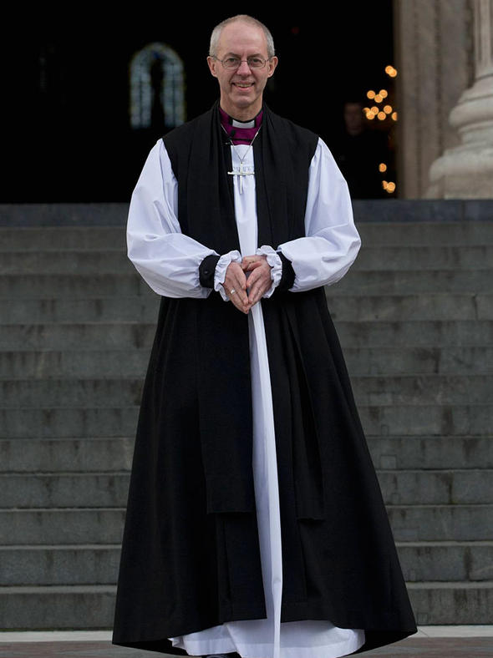
It professes the faith uniquely revealed in the Holy Scriptures and set forth in the catholic creeds, which faith the Church is called upon to proclaim afresh in each generation

Slide 6
Collect for Bible Sunday
Blessed Lord, who caused all holy scriptures to be written for our learning: help us so to hear them, to read, mark and inwardly digest them that through patience, and the comfort of your holy word, we may embrace and forever hold fast the hope of everlasting life, through Jesus Christ our Lord. Amen

Slide 7
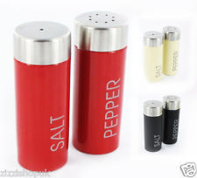

The Scriptures season our services
Can you think of examples?

Slide 8
In the following ways
Heard collectively
Forms part of the liturgy
  Before the confession
  In the Eucharistic Prayer
  In the post communion prayer

Slide 9
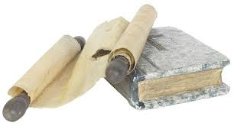
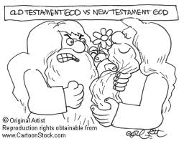
Two Volumes

Slide 10
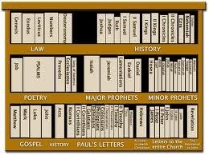

Slide 11
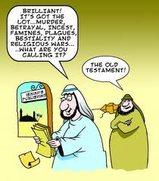

Old Testament
What three images come to mind when you think of the Old Testament?

Slide 12
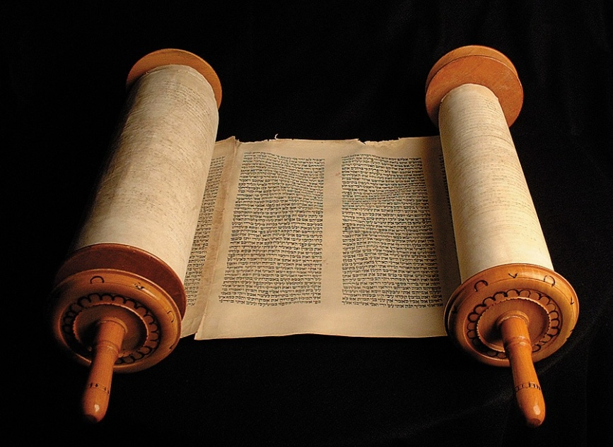
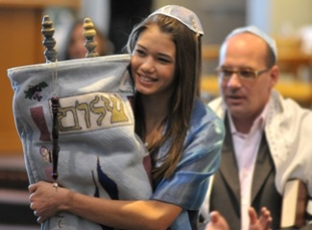
Different culture

Slide 13
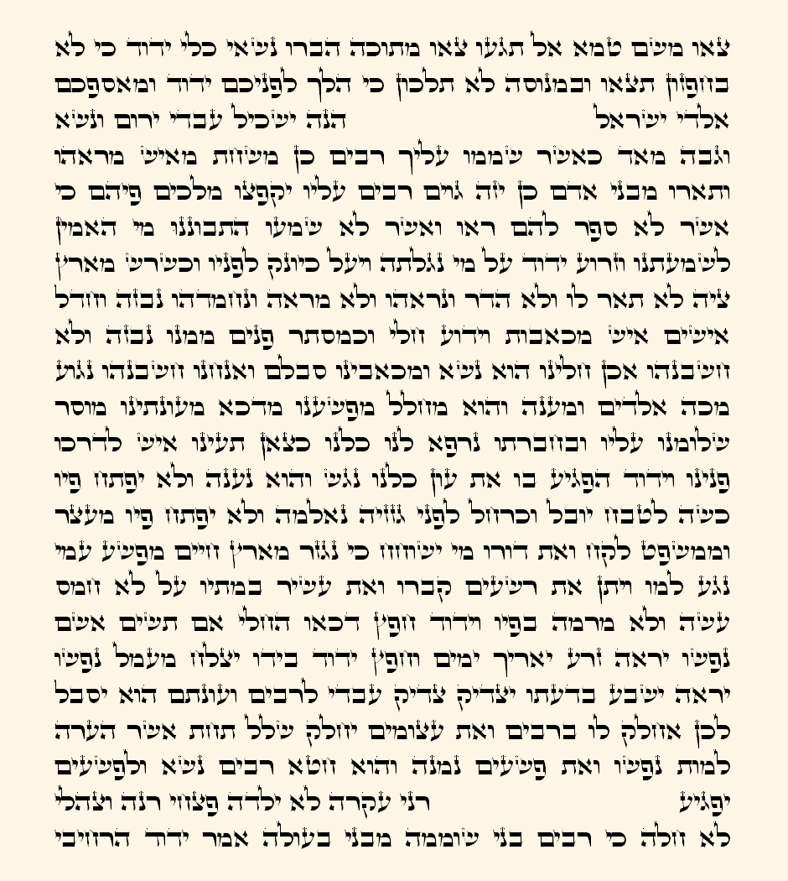
Different language

Slide 14
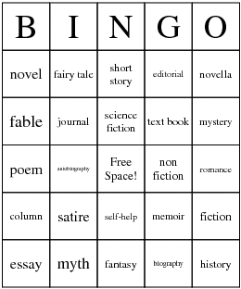
Different types of literature

Slide 15
The Old Testament has
Narrative
History
Wisdom
Romance
Prophecy
Apocalyptic
Genesis
1 and 2 Kings
Ecclesiastes
Song of Songs
Micah
Ezekiel

Slide 16
Narrative
¹⁵ Then the king of Egypt said to the Hebrew midwives, one of whom was named Shiphrah and the other Puah, ¹⁶ “When you serve as midwife to the Hebrew women and see them on the birthstool, if it is a son, you shall kill him, but if it is a daughter, she shall live.” ¹⁷ But the midwives feared God and did not do as the king of Egypt commanded them, but let the male children live. ¹⁸ So the king of Egypt called the midwives and said to them, “Why have you done this, and let the male children live?” ¹⁹ The midwives said to Pharaoh, “Because the Hebrew women are not like the Egyptian women, for they are vigorous and give birth before the midwife comes to them.” ²⁰ So God dealt well with the midwives. And the people multiplied and grew very strong. ²¹ And because the midwives feared God, he gave them families.

Slide 17
History
The sons of Jerahmeel, the firstborn of Hezron: Ram, his firstborn, Bunah, Oren, Ozem, and Ahijah. ²⁶ Jerahmeel also had another wife, whose name was Atarah; she was the mother of Onam. ²⁷ The sons of Ram, the firstborn of Jerahmeel: Maaz, Jamin, and Eker. ²⁸ The sons of Onam: Shammai and Jada. The sons of Shammai: Nadab and Abishur. ²⁹ The name of Abishur's wife was Abihail, and she bore him Ahban and Molid. ³⁰ The sons of Nadab: Seled and Appaim; and Seled died childless. ³¹ The son^{[d]} of Appaim: Ishi. The son of Ishi: Sheshan. The son of Sheshan: Ahlai. ³² The sons of Jada, Shammai's brother: Jether and Jonathan; and Jether died childless.

Slide 18
Wisdom
“I know that you can do all things,
and that no purpose of yours can be thwarted.
³ ‘Who is this that hides counsel without knowledge?’
Therefore I have uttered what I did not understand,
things too wonderful for me, which I did not know.
⁴ ‘Hear, and I will speak;
I will question you, and you make it known to me.’
⁵ I had heard of you by the hearing of the ear,
but now my eye sees you;
⁶ therefore I despise myself,
and repent^{[a]} in dust and ashes.”

Slide 19
Romance
Let him kiss me with the kisses of his mouth!
For your love is better than wine;
³ your anointing oils are fragrant;
your name is oil poured out;
therefore virgins love you.
⁴ Draw me after you; let us run.
The king has brought me into his chambers

Slide 20
Prophecy
^{2 [c]} The people who walked in darkness have seen a great light; those who dwelt in a land of deep darkness, on them has light shined. ³ You have multiplied the nation; you have increased its joy; they rejoice before you
as with joy at the harvest, as they are glad when they divide the spoil. ⁴ For the yoke of his burden, and the staff for his shoulder, the rod of his oppressor, you have broken as on the day of Midian. ⁵ For every boot of the tramping warrior in battle tumult and every garment rolled in blood will be burned as fuel for the fire. ⁶ For to us a child is born, to us a son is given; and the government shall be upon^{[d]} his shoulder,
and his name shall be called^{[e]} Wonderful Counsellor, Mighty God, Everlasting Father, Prince of Peace.

Slide 21
Apocalyptic
¹² Then the Spirit^{[a]} lifted me up, and I heard behind me the voice^{[b]} of a great earthquake: “Blessed be the glory of the Lord from its place!” ¹³ It was the sound of the wings of the living creatures as they touched one another, and the sound of the wheels beside them, and the sound of a great earthquake. ¹⁴ The Spirit lifted me up and took me away, and I went in bitterness in the heat of my spirit, the hand of the Lord being strong upon me. ¹⁵ And I came to the exiles at Tel-abib, who were dwelling by the Chebar canal, and I sat where they were dwelling.^{[c]} And I sat there overwhelmed among them seven days.

Slide 22
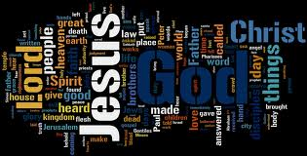
New Testament
Activity
What image comes to mind when you think of the New Testament?

Slide 23
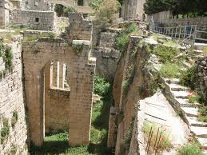
Different culture

Slide 24
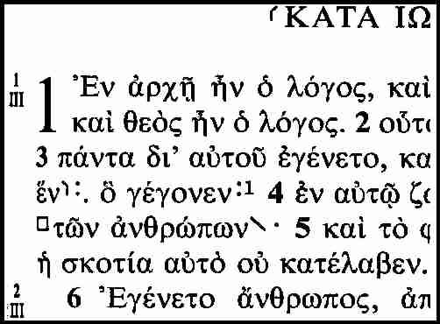
Different language

Slide 25
The New Testament
Story
Letters
Apocalyptic
Gospels and Acts
e.g., Paul
The Revelation

Slide 26
Story
When the day of Pentecost arrived, they were all together in one place. ² And suddenly there came from heaven a sound like a mighty rushing wind, and it filled the entire house where they were sitting. ³ And divided tongues as of fire appeared to them and rested^{[a]} on each one of them. ⁴ And they were all filled with the Holy Spirit and began to speak in other tongues as the Spirit gave them utterance.

Slide 27
Letters
Am I not free? Am I not an apostle? Have I not seen Jesus our Lord? Are not you my workmanship in the Lord? ² If to others I am not an apostle, at least I am to you, for you are the seal of my apostleship in the Lord.

Slide 28
Apocalyptic
After this I looked, and behold, a door standing open in heaven! And the first voice, which I had heard speaking to me like a trumpet, said, “Come up here, and I will show you what must take place after this.” ² At once I was in the Spirit, and behold, a throne stood in heaven, with one seated on the throne. ³ And he who sat there had the appearance of jasper and carnelian, and round the throne was a rainbow that had the appearance of an emerald. ⁴ Round the throne were twenty-four thrones, and seated on the thrones were twenty-four elders, clothed in white garments, with golden crowns on their heads. ⁵ From the throne came flashes of lightning, and rumblings^{[a]} and peals of thunder, and before the throne were burning seven torches of fire, which are the seven spirits of God, ⁶ and before the throne there was as it were a sea of glass, like crystal.

Slide 29
Approaching Scripture
Mary Magdalene

Slide 30
Different approaches
History
Literary
Liberationist
Bible as Drama or Story

Slide 31
The Bible as Drama
Act 1: Creation
Act 2: Fall
Act 3 Israel is chosen
Act 4: Jesus
Act 5: The Mission of the Church
Act 6: The Return of the King

Slide 32
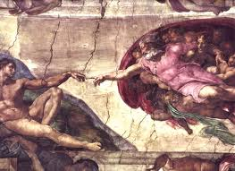

Slide 33
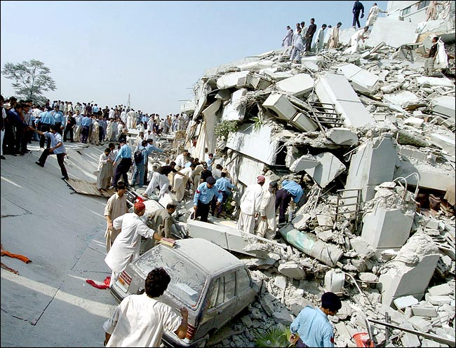

Slide 34
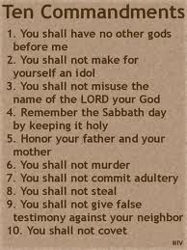

Slide 35
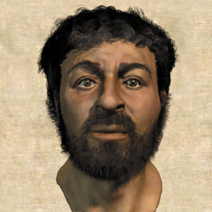

Slide 36
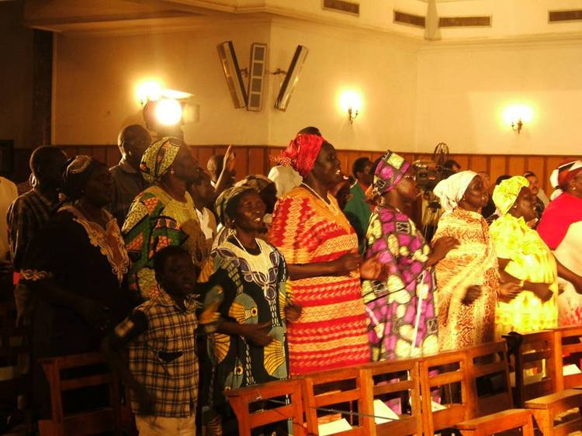

Slide 37
Consistent themes
God of grace and healing
God of invitation and inclusion
God of revelation and concealing
God who welcomes and embraces
God who allows (people) to stand outside

Slide 38
The Bible as story
Takes seriously the narrative
Embraces the loose ends (all stories have them)
Allows each of us to participate

Slide 39
Next week:
Creation and Fall
Please read Genesis 1-2, Psalm 8 and Isaiah 41
Spend some time thinking about all the times the Gospel writers showed that Jesus had power over all creation.

Slide 40
How comfortable are the Scriptures if you have a place in the story?

