Slide 1
Act 3: God chooses Israel

Slide 2
Aims
To provide space to look at the Bible
To introduce ourselves to the different parts of the story of the Bible
To be more comfortable in using the Bible in our lives and in the life of our Church

Slide 3
The Bible as Drama
Act 1: Creation
Act 2: Fall
Act 3 Israel is chosen
Act 4: Jesus
Act 5: The Mission of the Church
Act 6: The Return of the King

Slide 4
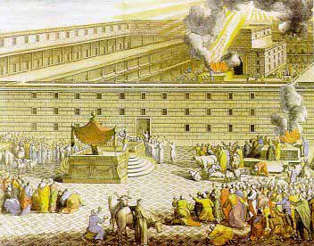
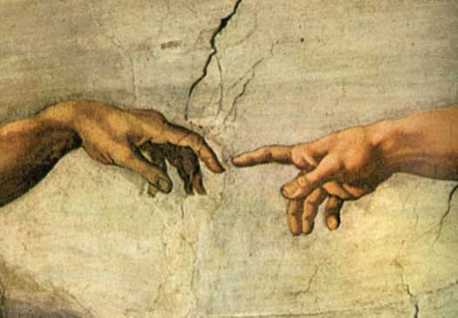
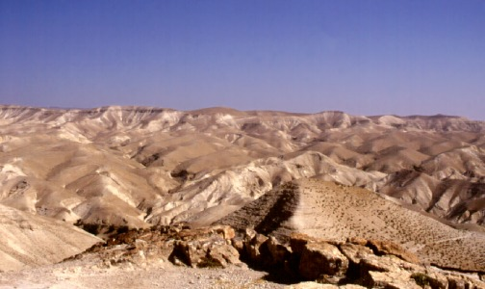
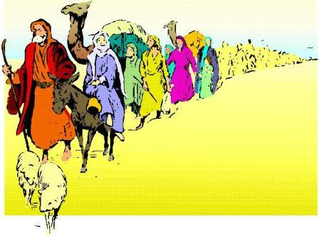
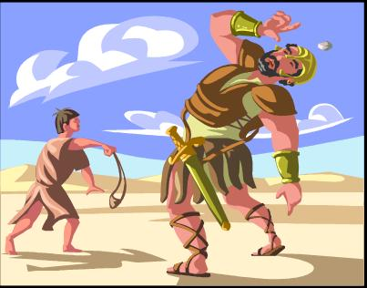
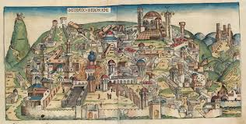
Time line
The Law
Sacrifice & Cult
Patriarchs
Covenant
Passover
Wisdom and Prophets
Moses
Monarchy

Slide 5
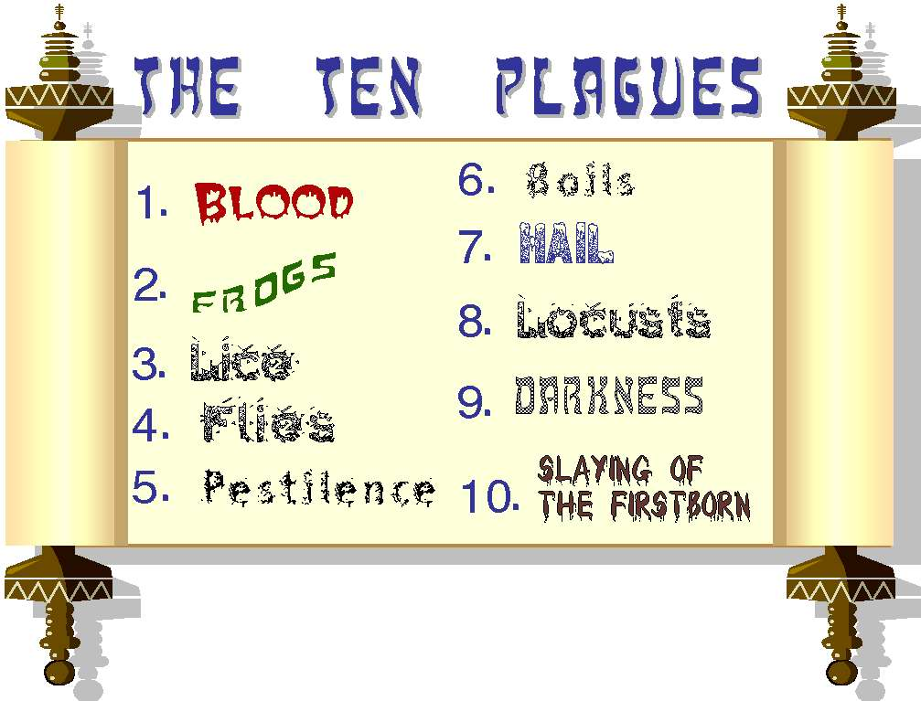
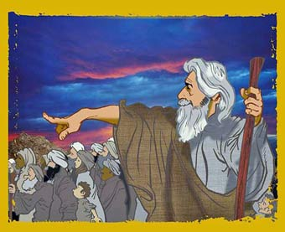
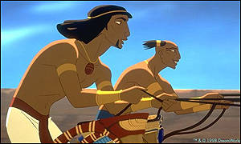
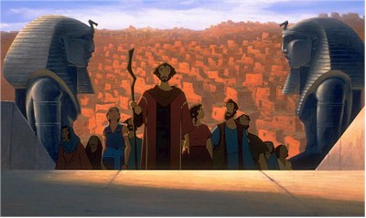
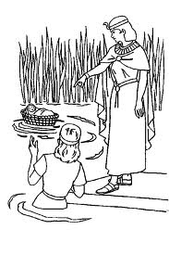
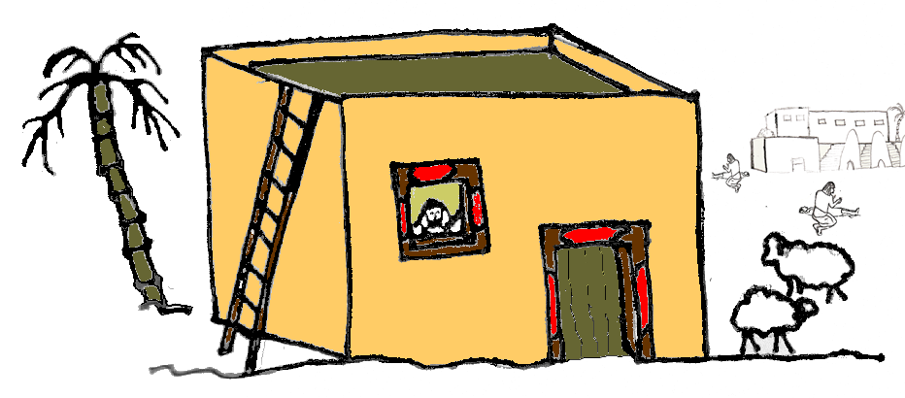
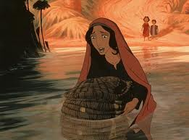
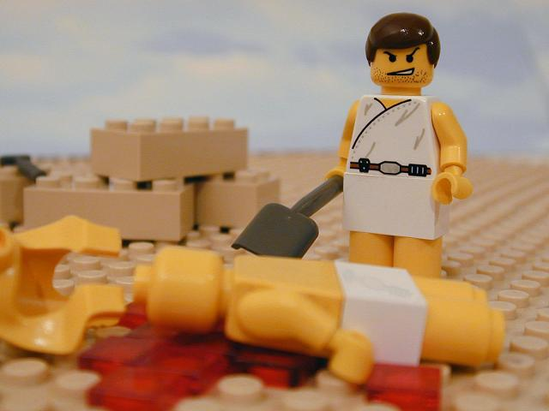
The story of Moses and the Exodus

Slide 6
Story of Exodus
Creation of Israel
    Slaves to Freedom
Passover
    Freedom to Covenant
Covenant
    Relationship with a Purpose

Slide 7
Exodus 19:3-6
Then Moses went up to God; the Lord called to him from the mountain, saying, ‘Thus you shall say to the house of Jacob, and tell the Israelites: You have seen what I did to the Egyptians, and how I bore you on eagles’ wings and brought you to myself. Now therefore, if you obey my voice and keep my covenant, you shall be my treasured possession out of all the peoples. Indeed, the whole earth is mine, but you shall be for me a priestly kingdom and a holy nation. These are the words that you shall speak to the Israelites.’
Notes:
The grace of God in action (4)
Israel belongs to God (5)
The task of Israel was to be a light to the world (6)

Slide 8
Exodus 19:3-6
Then Moses went up to God; the Lord called to him from the mountain, saying, ‘Thus you shall say to the house of Jacob, and tell the Israelites: You have seen what I did to the Egyptians, and how I bore you on eagles’ wings and brought you to myself. Now therefore, if you obey my voice and keep my covenant, you shall be my treasured possession out of all the peoples. Indeed, the whole earth is mine, but you shall be for me a priestly kingdom and a holy nation. These are the words that you shall speak to the Israelites.’
Notes:
The grace of God in action (4)
Israel belongs to God (5)
The task of Israel was to be a light to the world (6)

Slide 9
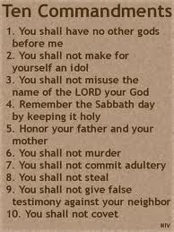
The Law is Good News (Exodus 20)
Sign of covenant
Notes:
The Ten Commandments are part of the grace of God

Slide 10
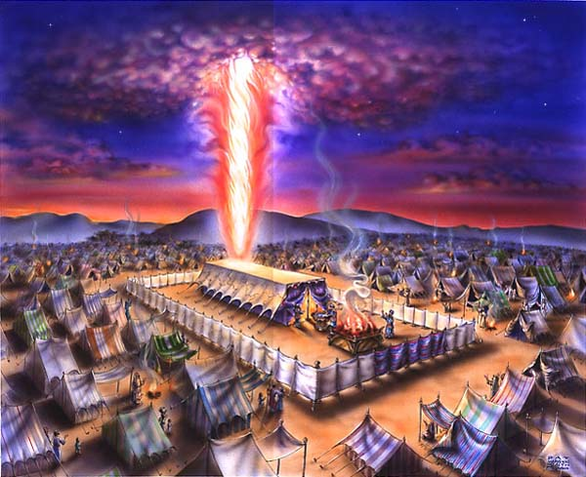
God lives with Israel
Building the Tabernacle
Intricate detail
God journeys with his people

Slide 11
Golden Calf
Human initiative (rather than divine)
Materials demanded (rather than willingly given)
A quick botch job (rather than intricate in detail)
Have an idol that cannot act or speak (rather than one who intervenes)

Slide 12
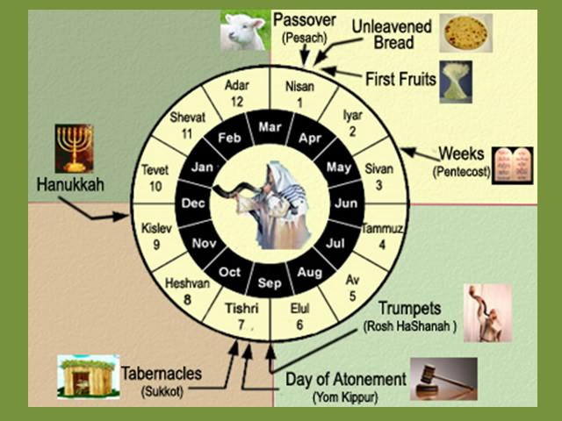
Leviticus: a regulated life
Notes:
Leviticus is normally thought of as boring and irrelevant rather than God’s means of ensuring that his chosen people live life well, and to maintain a relationship with him

Slide 13
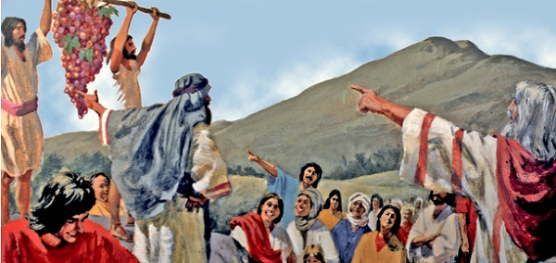
Numbers: Moving towards the Land
There be giants in the land
We can take it in God’s strength
Refusal
Destruction and Intercession
Wilderness

Slide 14
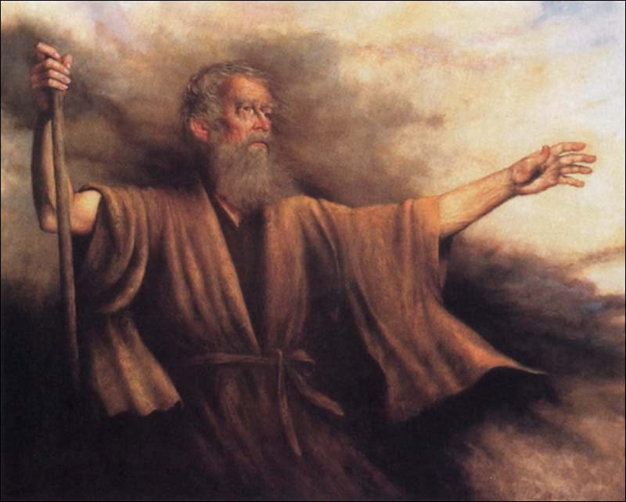
Deuteronomy

Slide 15

Joshua and Jericho
Notes:
Tell me the story

Slide 16
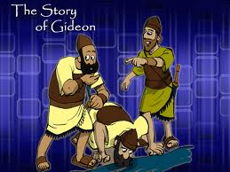
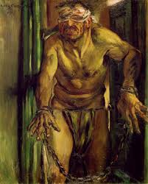
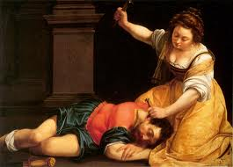
Judges: Loving and Forsaking

Slide 17
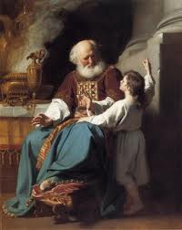
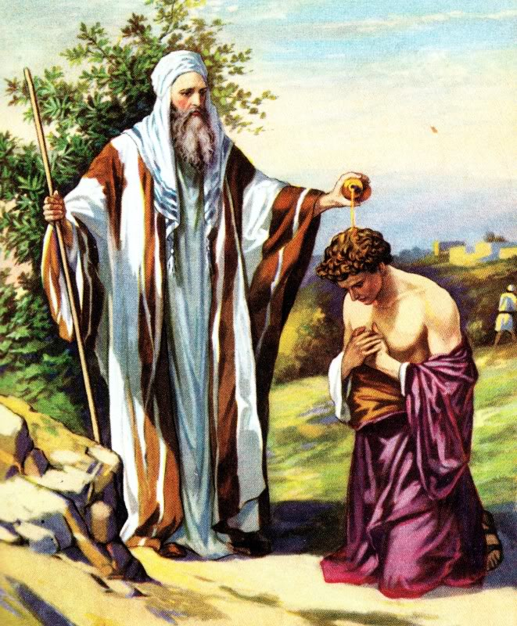
Monarchy

Slide 18
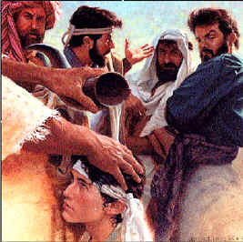
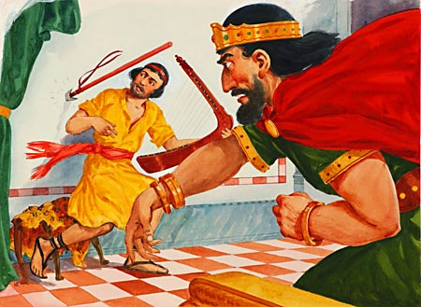
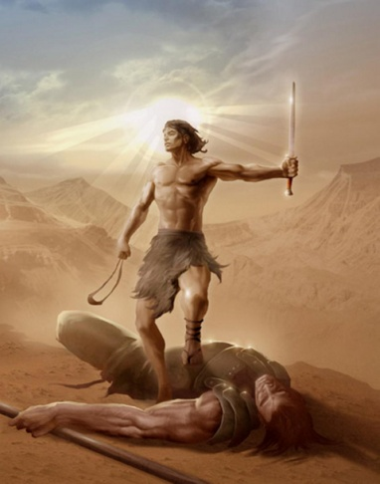
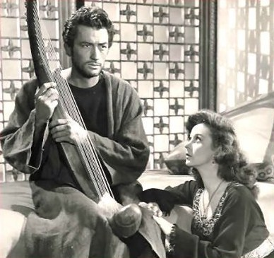
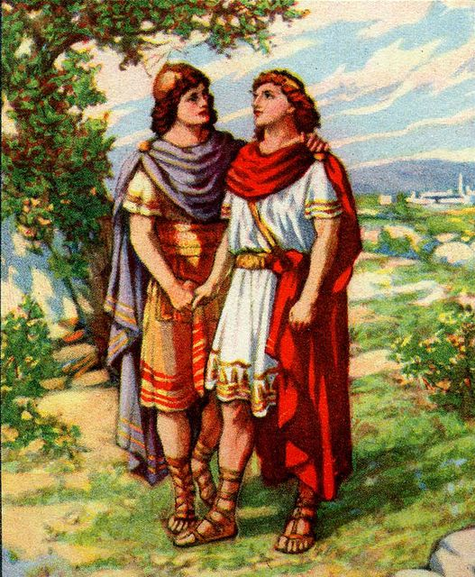
The Story of David

Slide 19
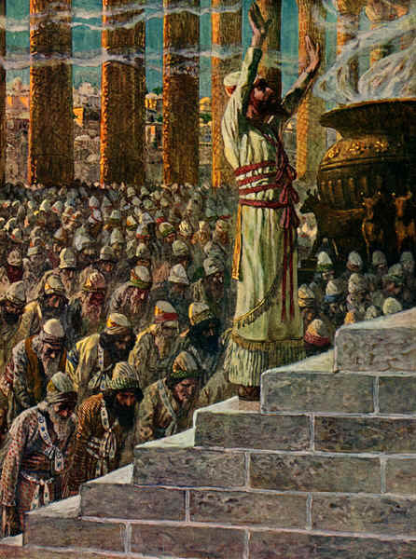
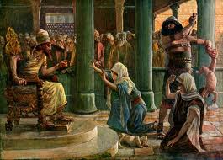
Solomon

Slide 20
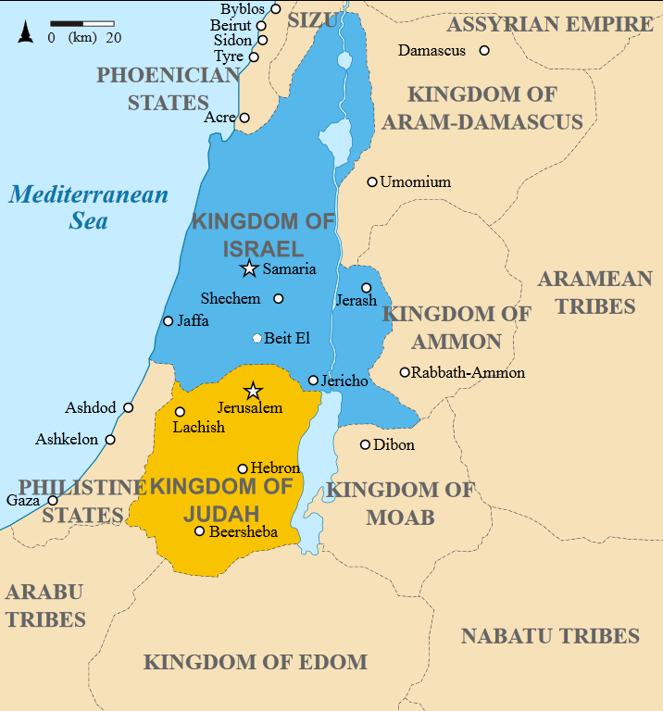

Slide 21
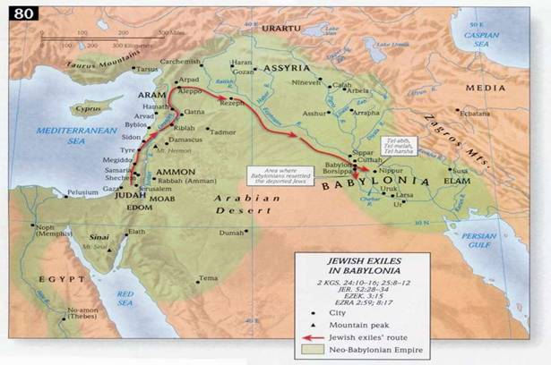

Slide 22
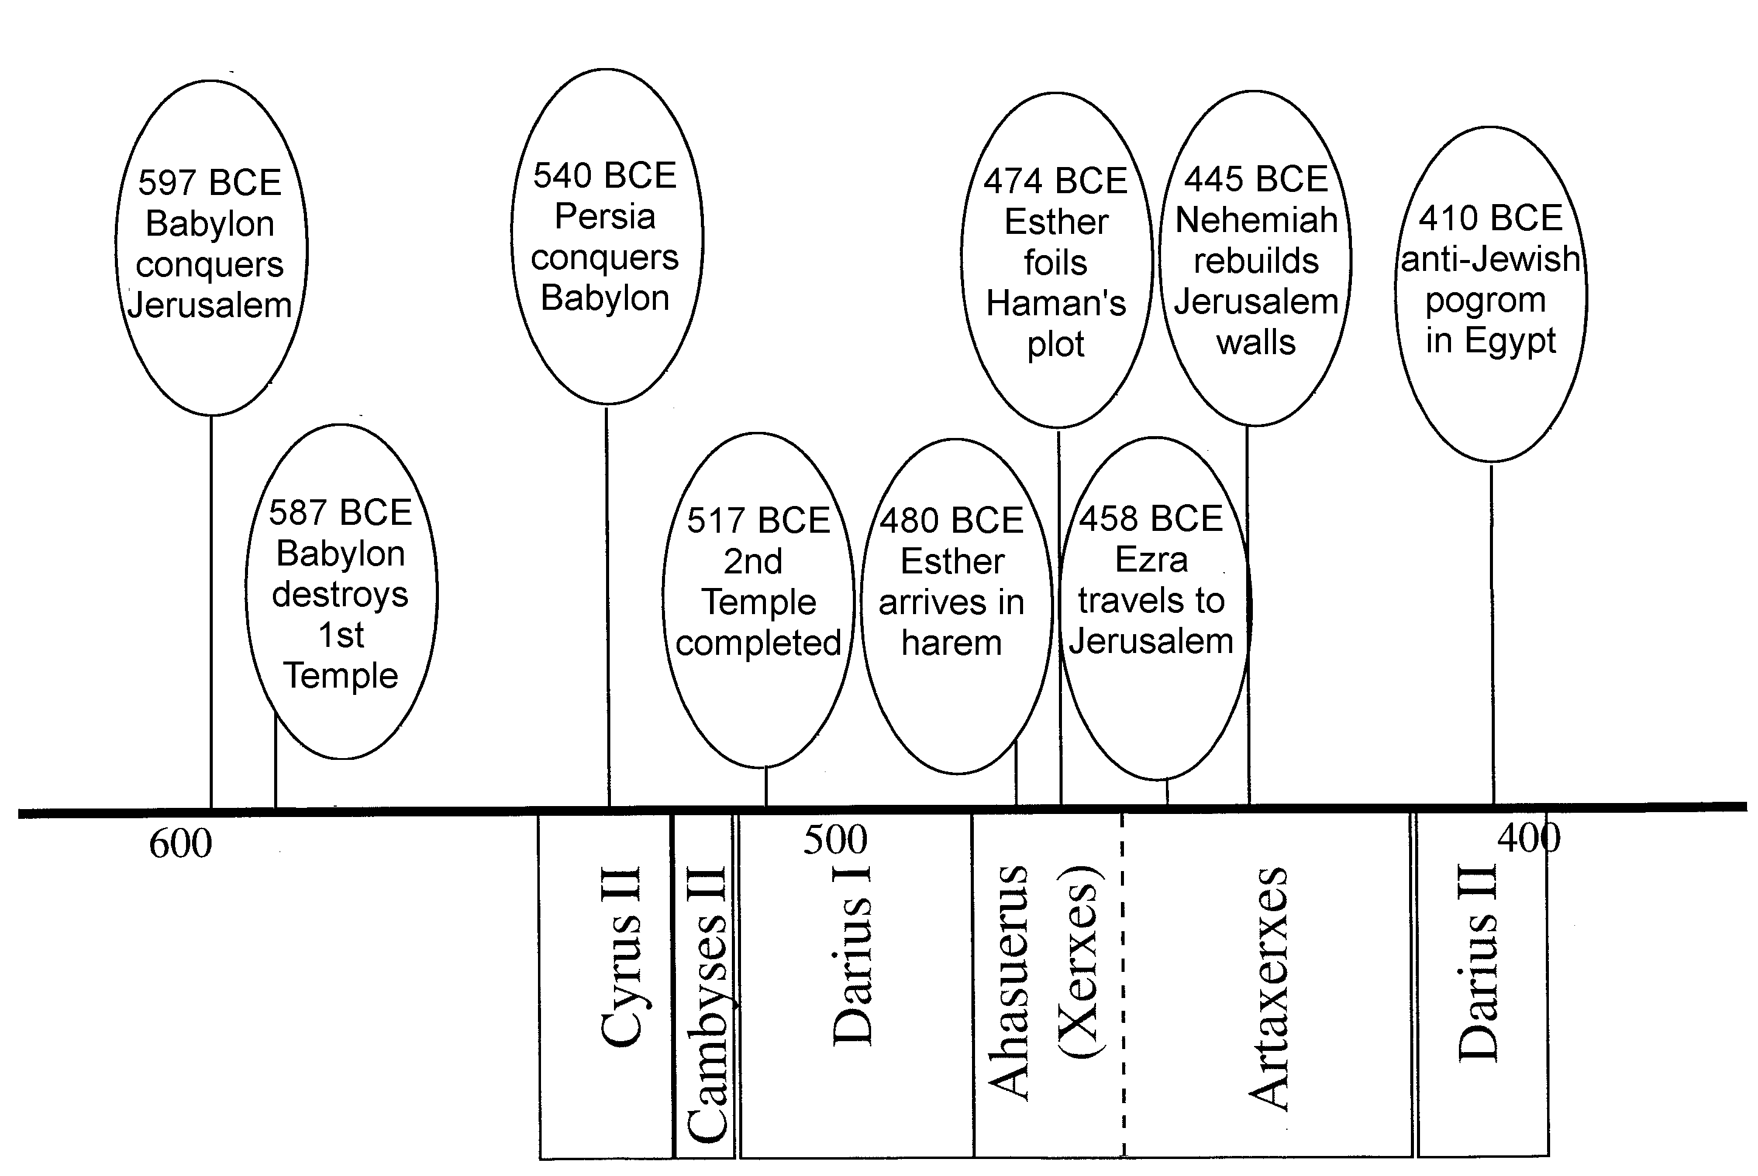
Exile

Slide 23
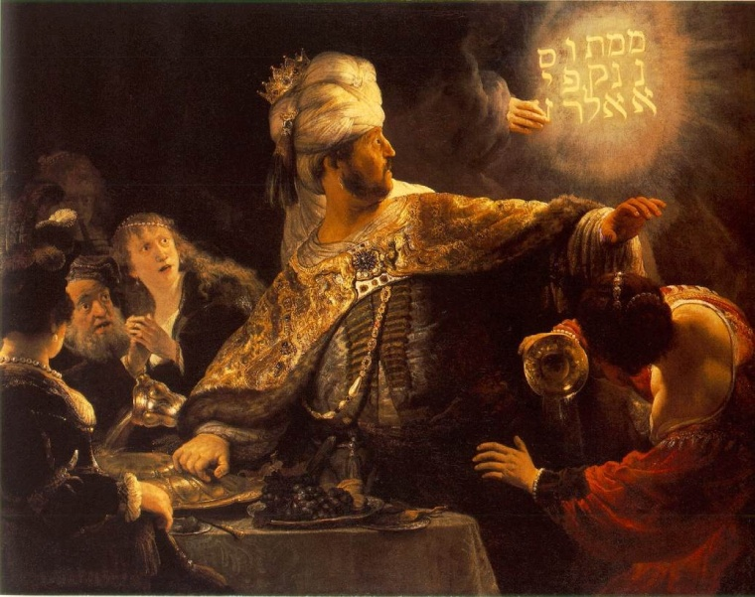
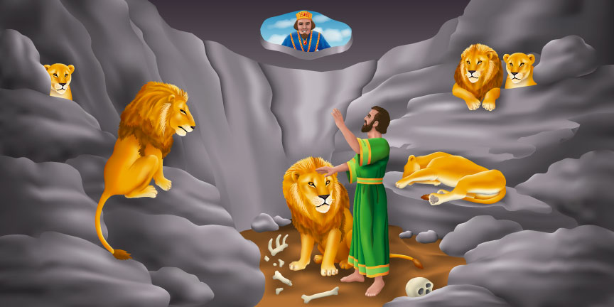
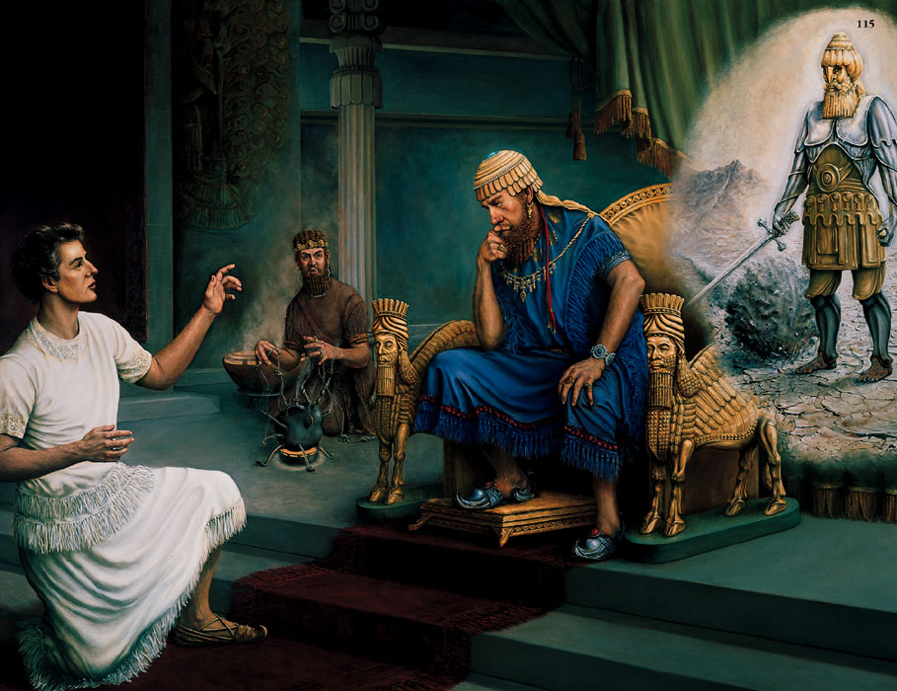
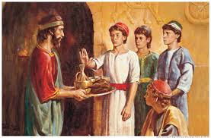
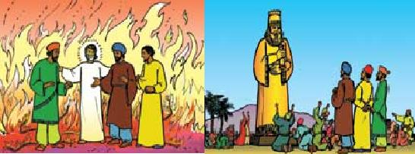
Daniel’s story

Slide 24
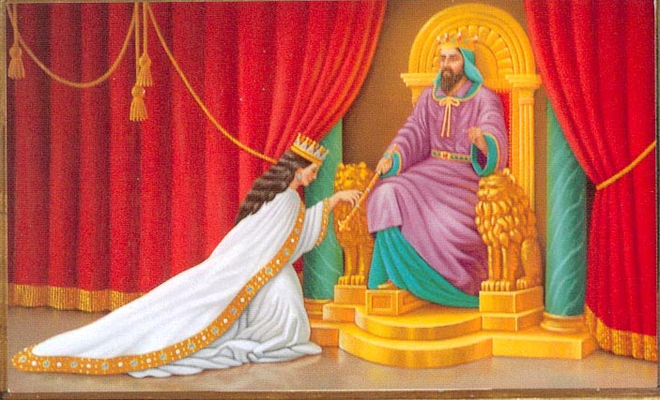
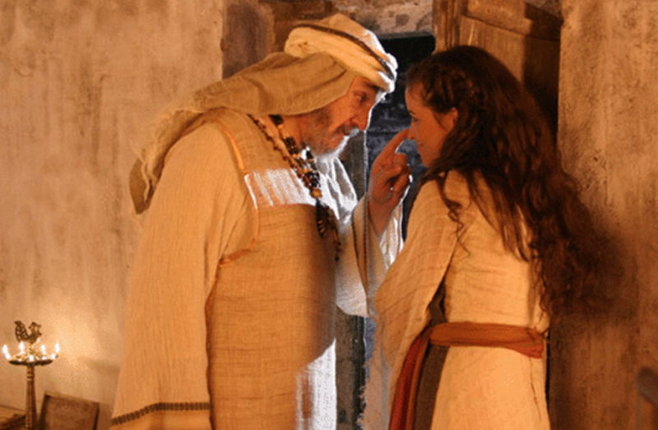
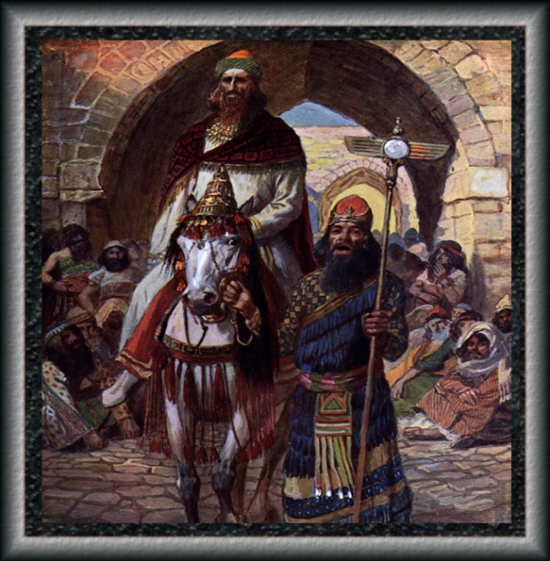
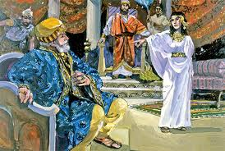
Esther’s Story

Slide 25
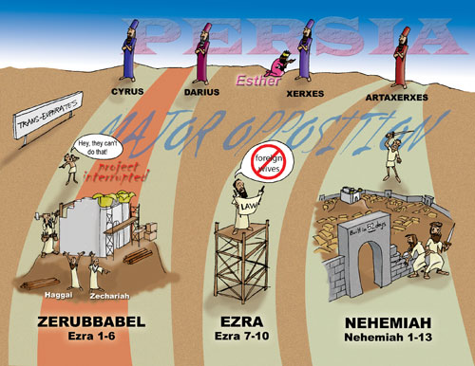
Ezra and Nehemiah

Slide 26
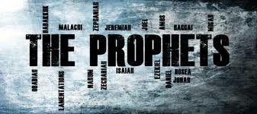
The Prophets

Slide 27
What did they do?
Often part of the establishment
    Isaiah’s vision takes place in the Temple
Even then had uncomfortable messages to give
    Nathan to David, Jeremiah to Jerusalem
The message often called Israel and Judah back to acting as the people of God
    What does the Lord require of you?
    He has told you, O mortal, what is good;
    and what does the Lord require of you
    but to do justice, and to love kindness,
    and to walk humbly with your God?

Slide 28
Who was their message for?
The Prophets both forthtold and foretold
Forthtelling is proclaiming to a contemporary situation.
Foretelling is making a prediction of the future; usually about hope that is to come

Slide 29
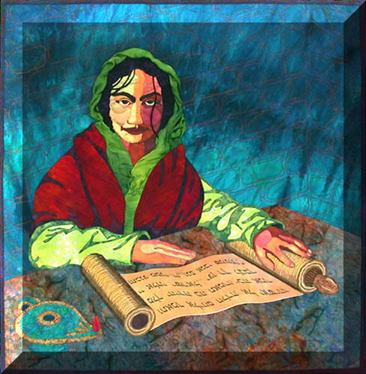
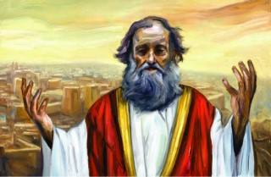
Minor Prophets

Slide 30
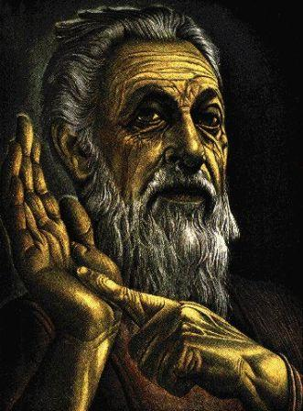
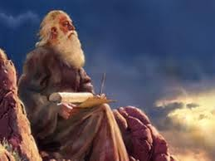
Major Prophets

Slide 31


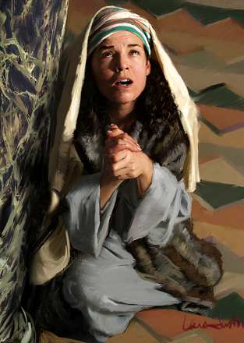



Slide 32

Light to the Gentiles
Gentile Woman
Example of faith to Israel
Grandmother of David

Slide 33
Story of Israel
Grace
Promise
Land
Covenant
Salvation
Law
Disobedience
Exile
Exclusion
Judgement

Slide 34


For next week

