Slide 1
Act 4: Jesus

Slide 2
Aims
To provide space to look at the Bible
To introduce ourselves to the different parts of the story of the Bible
To be more comfortable in using the Bible in our lives and in the life of our Church

Slide 3
The Bible as Drama
Act 1: Creation
Act 2: Fall
Act 3 Israel is chosen
Act 4: Jesus
Act 5: The Mission of the Church
Act 6: The Return of the King

Slide 4
Story of Israel
Grace
Promise
Land
Covenant
Salvation
Law
Disobedience
Exile
Exclusion
Judgement

Slide 5
Jesus did not emerge in a vacuum
Palestine under Roman occupation
Jewish expectations of deliverance
Ordinary men and women struggled to make ends meet
Many Jews felt in exile in their own land.
Notes:
A succession of roman procurators
Pharisees, Sadducees and the Covenanters at Qumran all have different modes of deliverance, even with the idea of Messiah there are differing concepts (davidic king, priestly messiah, teacher (Samaritans), prophetic)
The land where Jesus lived had known several famines in 20 years. Roman and Temple tax took most of their income, and one imagines there was little time in which to reimagine a different future
For many Jews, they were home; but not home

Slide 6
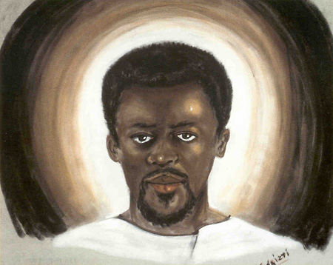
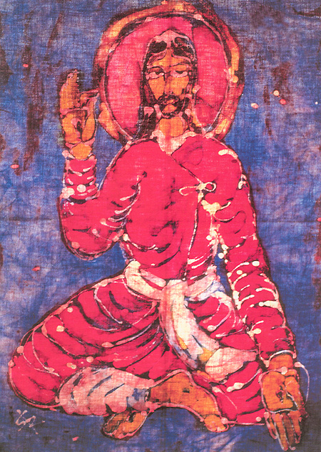
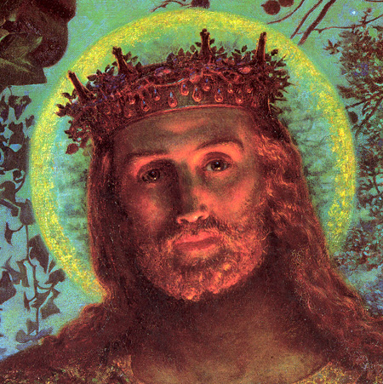
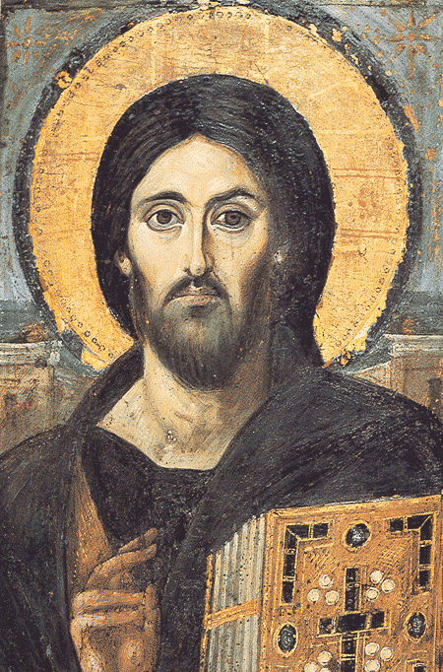
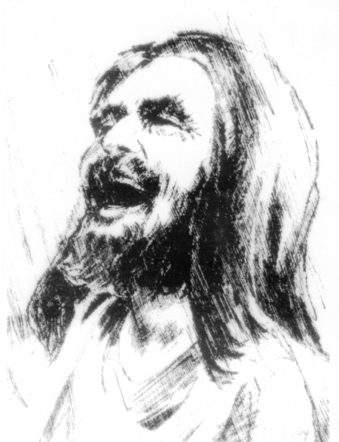

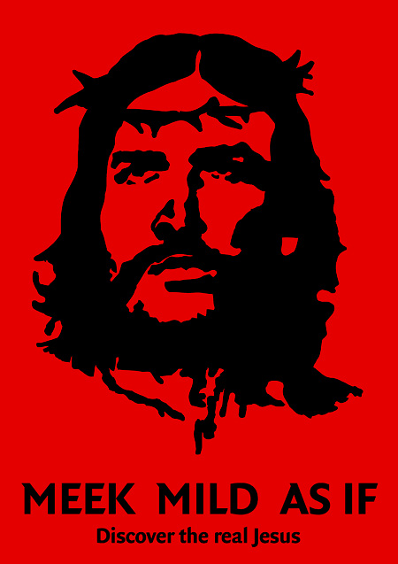
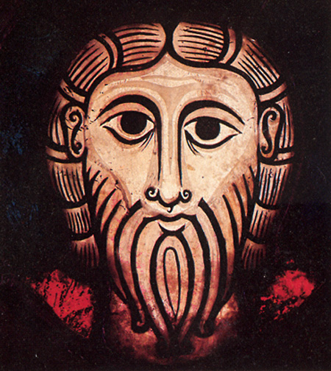

Slide 7
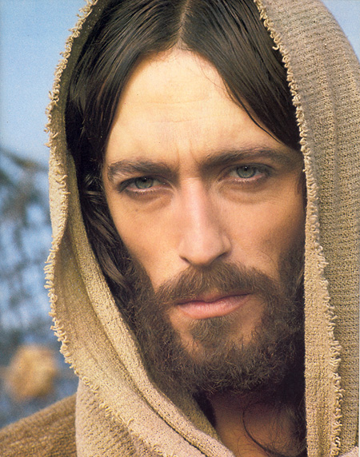
What are the contours of Jesus’ life?

Slide 8
Miracles
Son of man
Family
Stories
Death
Jewish
Opponents
Laughter
lord
Teaching
denial
betrayal
teacher
healer
god
Messiah
Resurrection
Son of God
Disciples

Slide 9
A Journey to Jerusalem
Baptism
Gathering a community
Teaching and Healing
Opposition
Confession Time
Teaching about who he is
To Jerusalem
Opposition
Betrayal, Arrest and Trial
Death
Easter

Slide 10
The Evangelists interpret Jesus
Mark
    Earliest gospel, short and snappy, two parts with everything from 8:31 a journey to Jerusalem
Matthew
    Jesus the Teacher (new Moses), Son of David, the Jewish Messiah.
Luke
    Jesus the healer, saviour of the world with a bias to the poor
John
    Jesus is God, I AM sayings
Notes:
Interpretation does not mean that something is not true. The oral tradition is important.

Slide 11
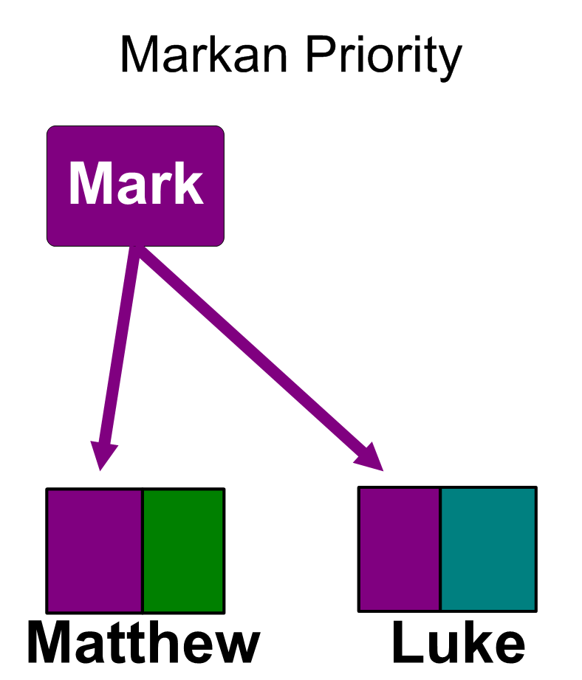

Slide 12
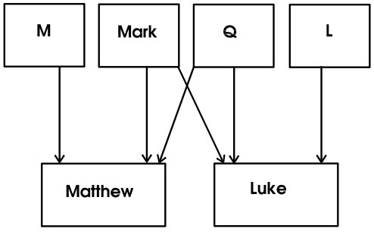

Slide 13
Tools for the Story
Story of Jesus
Story of Israel – Story of a covenant people
Story of Mark’s community

Slide 14
Marcan Overview
Introduction (1:1-15)
  Jesus is the Messiah, the Son of God
Jesus, the Bearer of the Kingdom (1:16-8:26)
  Jesus’ authority and response to it
  Jesus’ disciples
  Training of the disciples
The Road to Golgotha (8:27-15:41)
  The Journey to Jerusalem
  Jesus in the Temple
  Towards the Cross
Epilogue (16:1-8) He is Risen or the Tomb is Empty

Slide 15
Mark’s Jesus
We know who Jesus is for Mark
  Some of the characters do not: disciples, authorities
  Beware of reading into Mark later Christian understandings
The Messianic Secret
  Dramatic plot
  Corrective?
  Missional necessity
The ‘one like a Son of Man’
  What on earth does this mean (self-reference, human being or heavenly/divine figure)

Slide 16
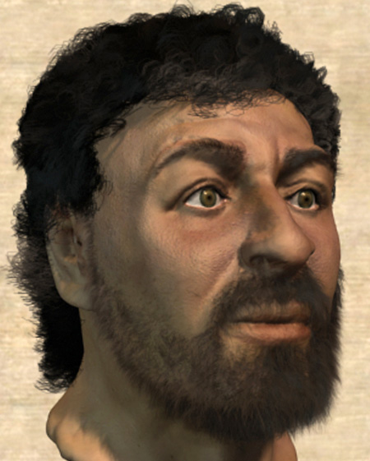
Understandings of Jesus

Slide 17
Gospel beginnings
Mark
    The Baptist
Matthew
    Family Tree
Luke
    Zechariah and Elizabeth
John
    Before time and space

Slide 18
Gospel Endings
Mark
    A tomb that is empty
Matthew
    The Great Commission
Luke
    Worshipping in the Temple
John
    By Lake Tiberius in Galilee

Slide 19


Slide 20
Any Questions
About Jesus
About the Course so far

Slide 21
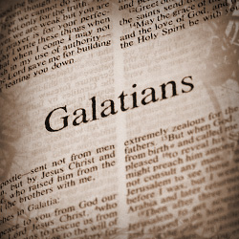
For next week

