Slide 1
Acts 5 and 6: Mission and Return

Slide 2
Aims
To provide space to look at the Bible
To introduce ourselves to the different parts of the story of the Bible
To be more comfortable in using the Bible in our lives and in the life of our Church

Slide 3
The Bible as Drama
Act 1: Creation
Act 2: Fall
Act 3 Israel is chosen
Act 4: Jesus
Act 5: The Mission of the Church
Act 6: The Return of the King

Slide 4
Staying in Jerusalem
Jesus People who worshipped in the Temple and met in homes
Well-thought of by people (miracles, good deeds)
Attracted opposition from those in authority

Slide 5
The ‘Jesus Way’ did not emerge in a vacuum
Palestine under Roman occupation
Church was largely Jewish
Jewish expectations of deliverance
Jesus the Messiah
Ordinary men and women struggled to make ends meet
The Kingdom had come
Many Jews felt in exile in their own land.
Followers of Jesus believed the exile had ended
Notes:
A succession of roman procurators
Pharisees, Sadducees and the Covenanters at Qumran all have different modes of deliverance, even with the idea of Messiah there are differing concepts (davidic king, priestly messiah, teacher (Samaritans), prophetic)
The land where Jesus lived had known several famines in 20 years. Roman and Temple tax took most of their income, and one imagines there was little time in which to reimagine a different future
For many Jews, they were home; but not home

Slide 6
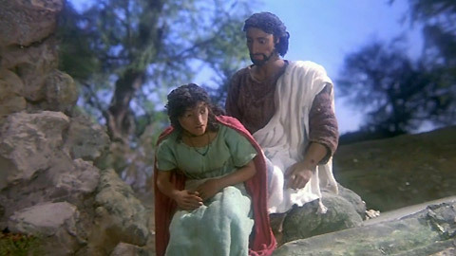
Whatever had happened was something extraordinary

Slide 7
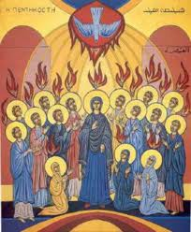
Pentecost
Waited in Jerusalem
Like a sound of wind and appearance of fiery tongues
Spoke in different languages
A new community begins
Notes:
Continuity with the past
Contours to interpret life are the same
Link with the OT story of Babel
Foundation of a new community – how distinct is difficult to tell

Slide 8
Redefinitions of belief
The Torah
    Jesus had given interpreted the Torah differently
The Temple
    Homes became increasingly important
Belief in one God
    Working out what to do with Jesus
The Land
    Gradual re-thinking of the covenant

Slide 9
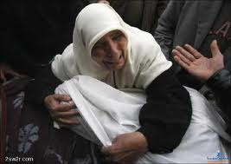
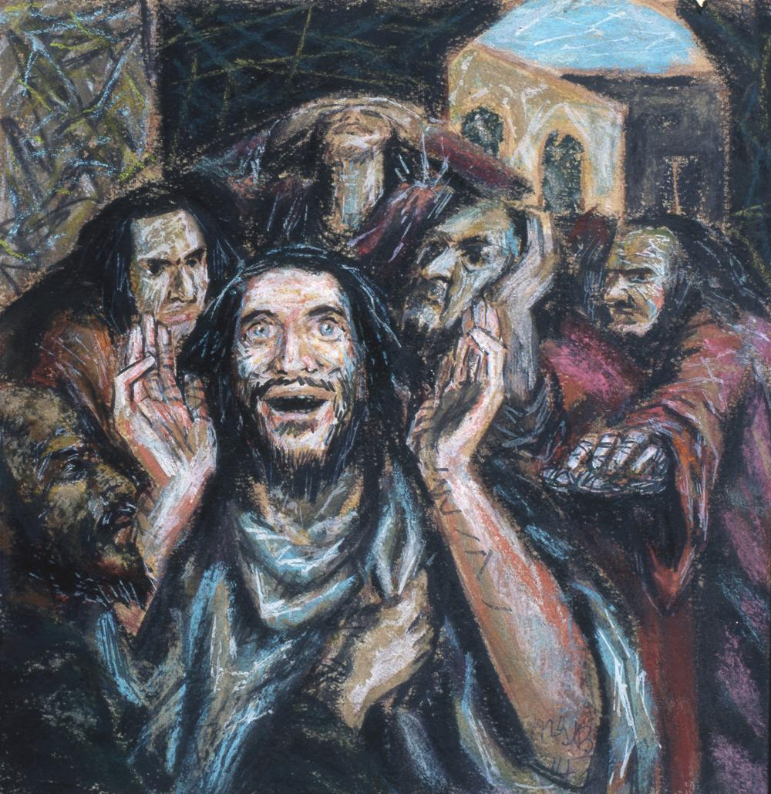
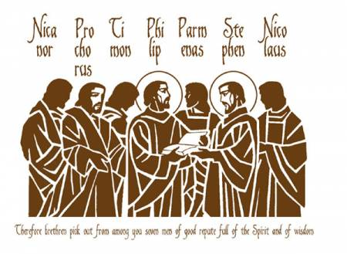
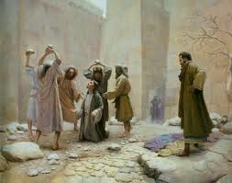
Persecution spreads the Message

Slide 10
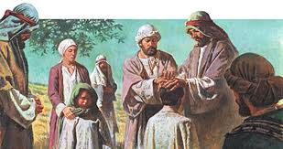
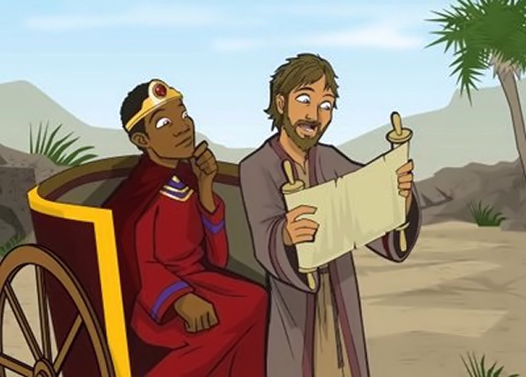
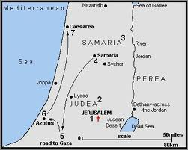
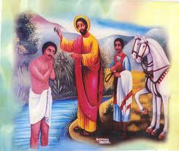
Samaria

Slide 11
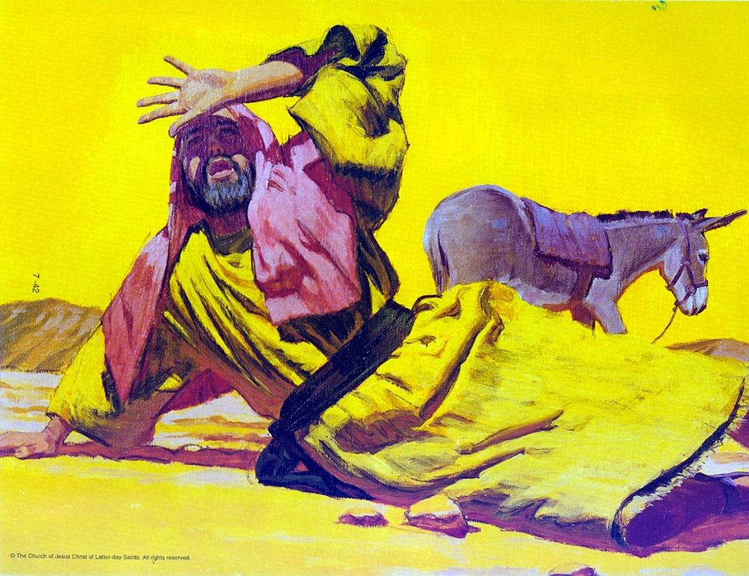
Surprise
Opposed the followers of Jesus
On his way to arrest followers of the Way
Blinded
Taken to Damascus
After three days, Ananias comes and prays for healing
Saul is baptised
Proclaims Jesus as Messiah and flees Damascus

Slide 12
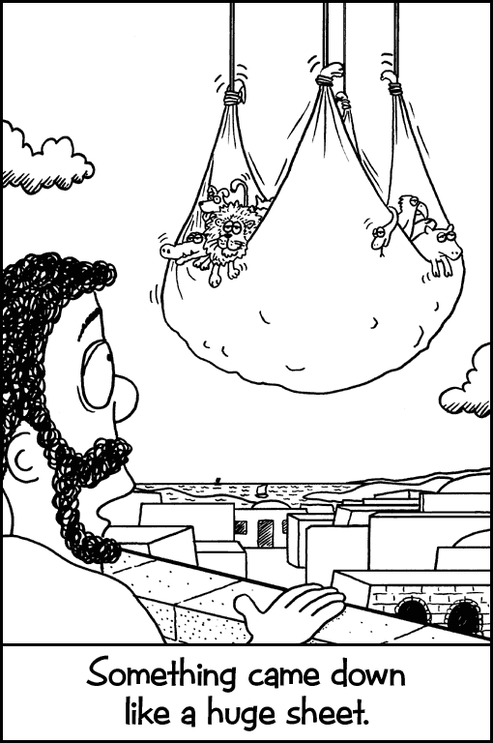
Visions
Cornelius has a vision in which God says to send for a man called Simon Peter
Peter has a vision of unclean food
Peter goes to Cornelius
Peter preaches
Baptised in the Holy Spirit
Baptised without becoming Jews

Slide 13
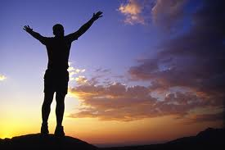
What now?
What were the ground rules?
What was the basis of the ground rules?

Slide 14
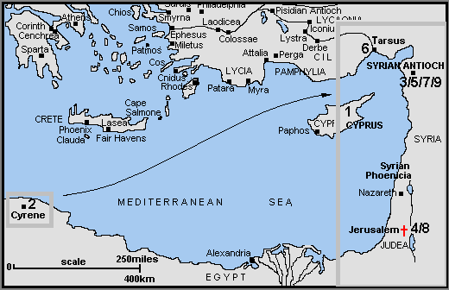
Moving outwards
Church is growing in the Diaspora
Barnabas and Saul sent out on a mission
Church communities form

Slide 15
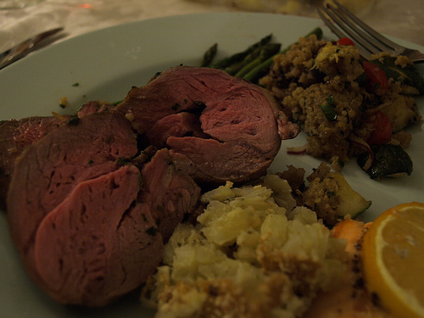
Tension

Slide 16
Redefinitions of belief
The Torah
    Jesus had interpreted the Torah differently. Followers of Jesus interpreted Torah differently
The Temple
    Homes become central to many followers of Jesus
Belief in one God
    Jesus is seen as being alongside God
The Land
    Identity becomes more focused on the Messiah

Slide 17
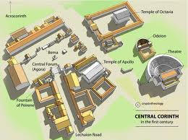
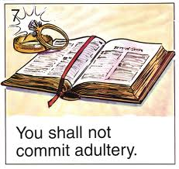
Corinth: a case in sexual ethics
Freedom
scandal

Slide 18
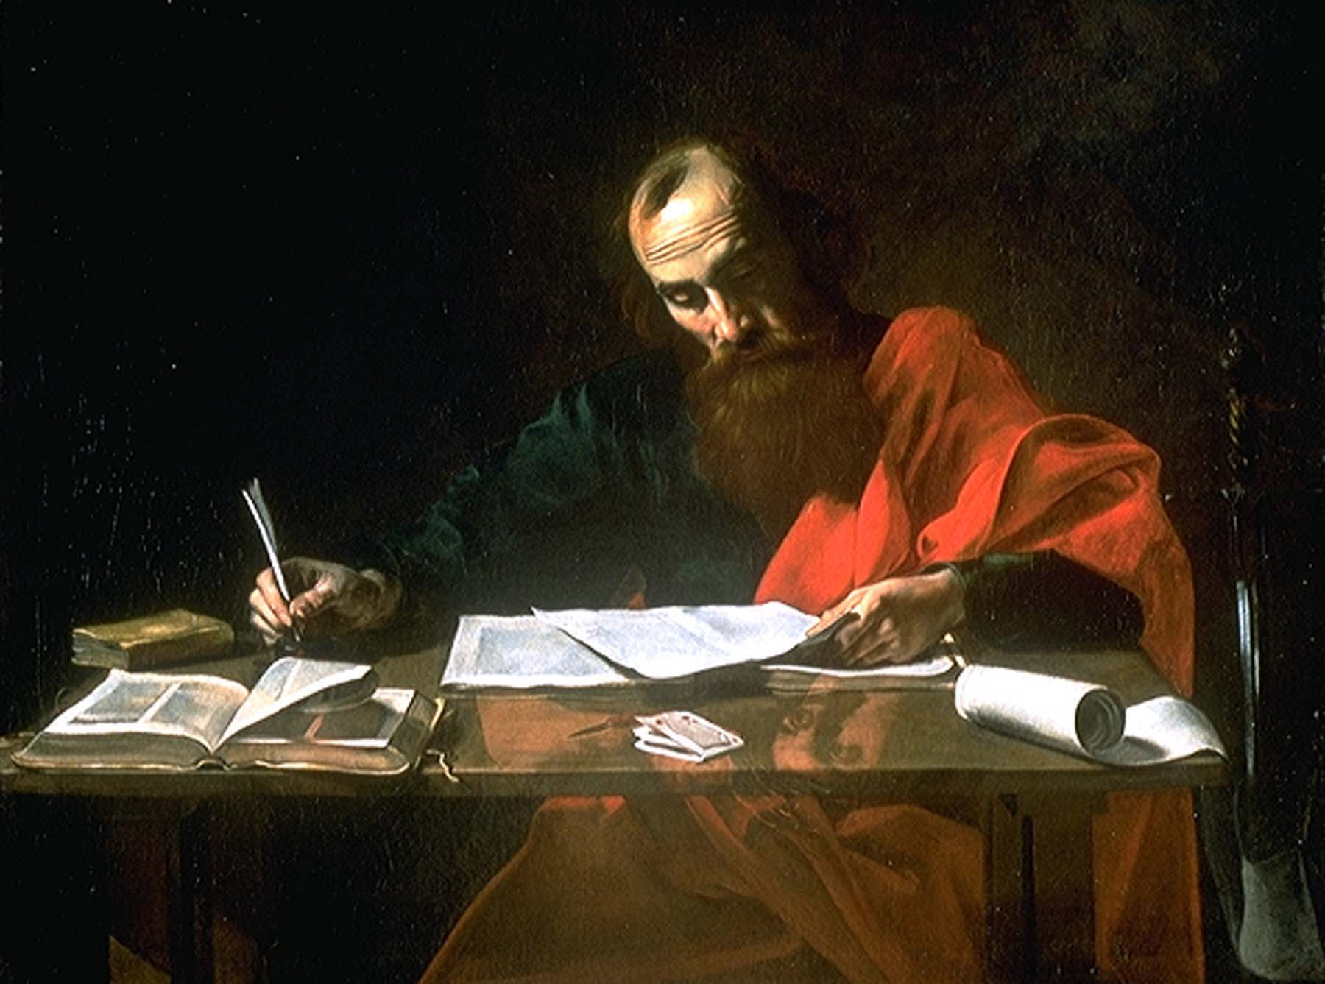
Letters

Slide 19


Who is Mr Head?
What can you tell about him from Mr Ratcliffe’s reply?

Slide 20
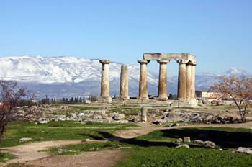
Corinth
¹¹ For it has been reported to me by Chloe’s people that there are quarrels among you, my brothers and sisters.^{[e]}
¹⁴ I thank God^{[f]} that I baptized none of you except Crispus and Gaius, ¹⁵ so that no one can say that you were baptized in my name. ¹⁶ (I did baptize also the household of Stephanas; beyond that, I do not know whether I baptized anyone else.)

Slide 21
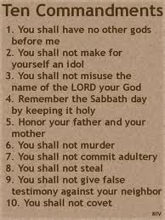
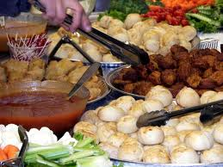
Eating food offered to idols
Practice and belief

Slide 22
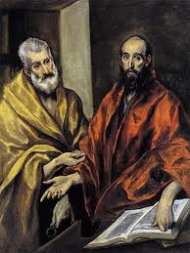
Galatians
Do we keep the law or not?
Cannot keep the law – it is impossible
Law just reminds us that we are sinful
It is all about grace. Grace comes from Abraham; not Moses

Slide 23
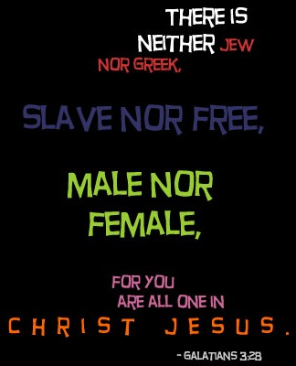

Slide 24
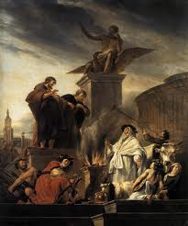
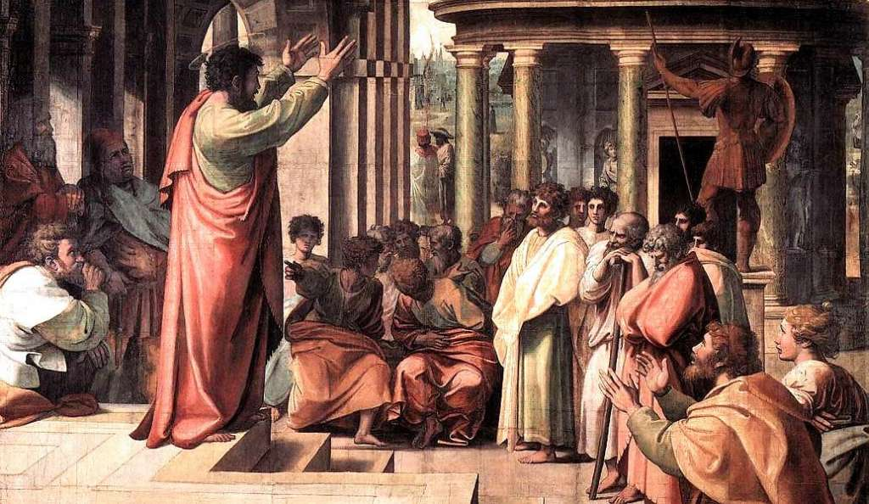
Paul the Missionary

Slide 25
Paul the Pastor
³ For I could wish that I myself were accursed and cut off from Christ for the sake of my own people,^{[a]} my kindred according to the flesh. ⁴ They are Israelites, and to them belong the adoption, the glory, the covenants, the giving of the law, the worship, and the promises; ⁵ to them belong the patriarchs, and from them, according to the flesh, comes the Messiah,^{[b]} who is over all, God blessed for ever.^{[c]} Amen.

Slide 26
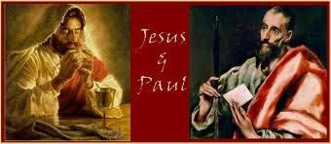
Paul the Theologian
The King
The Kingdom
The Return of the King

Slide 27
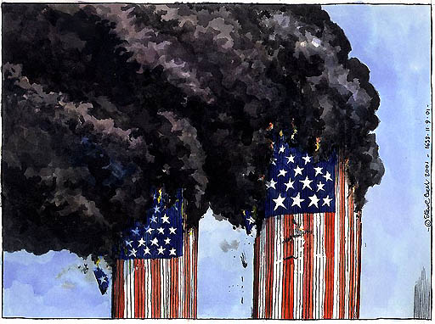
The Revelation

Slide 28
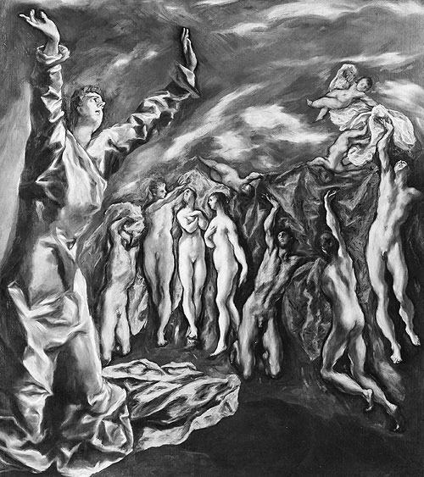
El Greco Vision of John

Slide 29
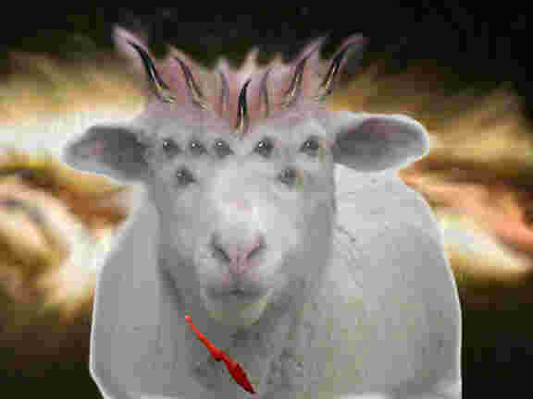

Slide 30
One Story
A God of grace
A God of hope
A God of judgement
A God of the imagination

Slide 31
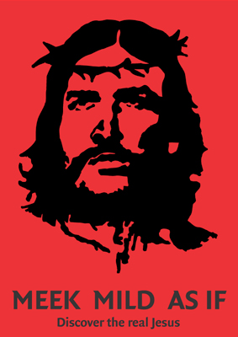
God’s story, our story

